Slide 1

Welcome to ActiveNet
Click to Begin

Slide 2
Error!
Please follow the on-screen
instructions to continue.
Go Back

Slide 3
Complete
Please navigate to the next module
in the course to continue.
Restart Course

Slide 4
ActiveNet
ActiveNet is full of features to help us accomplish everyday tasks. From Course Registrations, Facility Reservations and Customer Organization to Lagoon Permits, Point of Sale Procedures and Sports Leagues, we use this important system in a meaningful manner.
Welcome to ActiveNet
Purpose of Trainer
This training system will guide you through common procedures when modifying accounts, taking registrations, processing POS transactions and reserving facilities. Upon successful completion of this course, you will gain access to our system and work with other staff to complete these tasks.
Next

Slide 5
“Before We Continue”
Each module within this course contains “Before We Continue” notes. These notes include the City of Carlsbad’s policies and procedures that relate directly on the module following.
Course
Instructions
Read to Understand
Be sure to read and understand the policies and procedures so you may answer the related questions on the module exam.
Discuss
Each module is named according to the material it covers. Please feel free to use the discussion board for help from your peers. Do not be afraid to ask your peers for assistance on topics you do not understand.
Back
Next

Slide 6
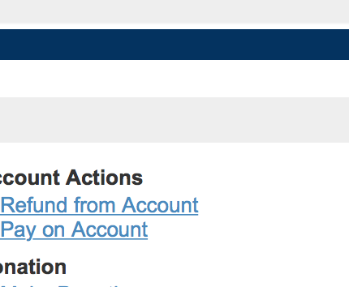
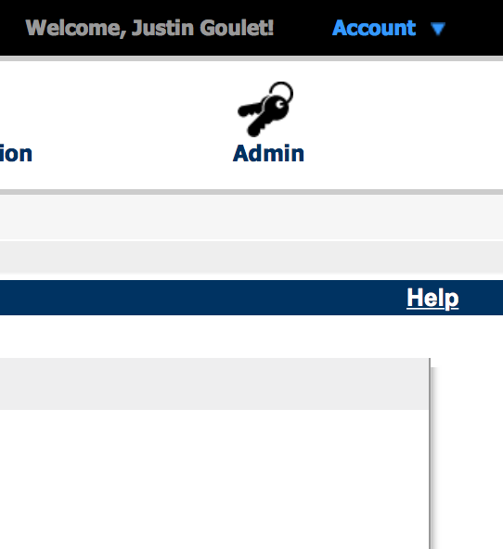
On ActiveNet,
Blue means Live
while
Yellow means Trainer
ActiveNet
Tips
A “Help” menu appears on any page to provide you with instant help for the page you currently have open.
Back
Next

Slide 7
No Typing Needed!
For the sake of this course, you do not need to type any data into the text fields. Simply click the correct field and follow the on-screen instructions!
Bugs
If you come across a bug in the trainer, click the arrow on the webpage to advance to the next screen to send us related feedback.
Please note that you will still be tested on the related material!
Feedback Wanted!
We want to know your feedback! Whether there is a bug, an error in context or another topic you want us to cover, Let Us Know!
To navigate each screen, it is highly recommended that you select the button on the slide, not the arrows on the side, to progress. The tutorials are made to jump from page whereas the side buttons are not.
ActiveNet Trainer
Tips
Back
Next

Slide 8
Before you continue..
Before you continue with the course material, note that each exam’s pass-rate. This is the grade you must get on the exam in order to continue. You only have 2 attempts to pass before your access is restricted.
Exam Contents
Each exam is solely based on the content provided in the module. With a heavy emphasis on policy, you must be able to answer the questions correctly to proceed.
Feedback
If you have any questions, comments, or additional feedback, please contact the ActiveNet Administrative staff by using the 'Feedback' option within the related course.
Good Luck!
Almost
Ready!
Back
Get Familiar

Slide 9
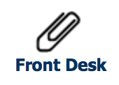
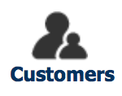


Interactive!
This trainer is meant to be as interactive as possible with no typing required. We want to focus on the process to ensure you are prepare to use the system.
Banner Icons:
Before we begin the modular courses, let's get familiar with how these tutorials work. Select an item from the below banner to get started.
Time to Get
Familiar
Back
Next

Slide 10
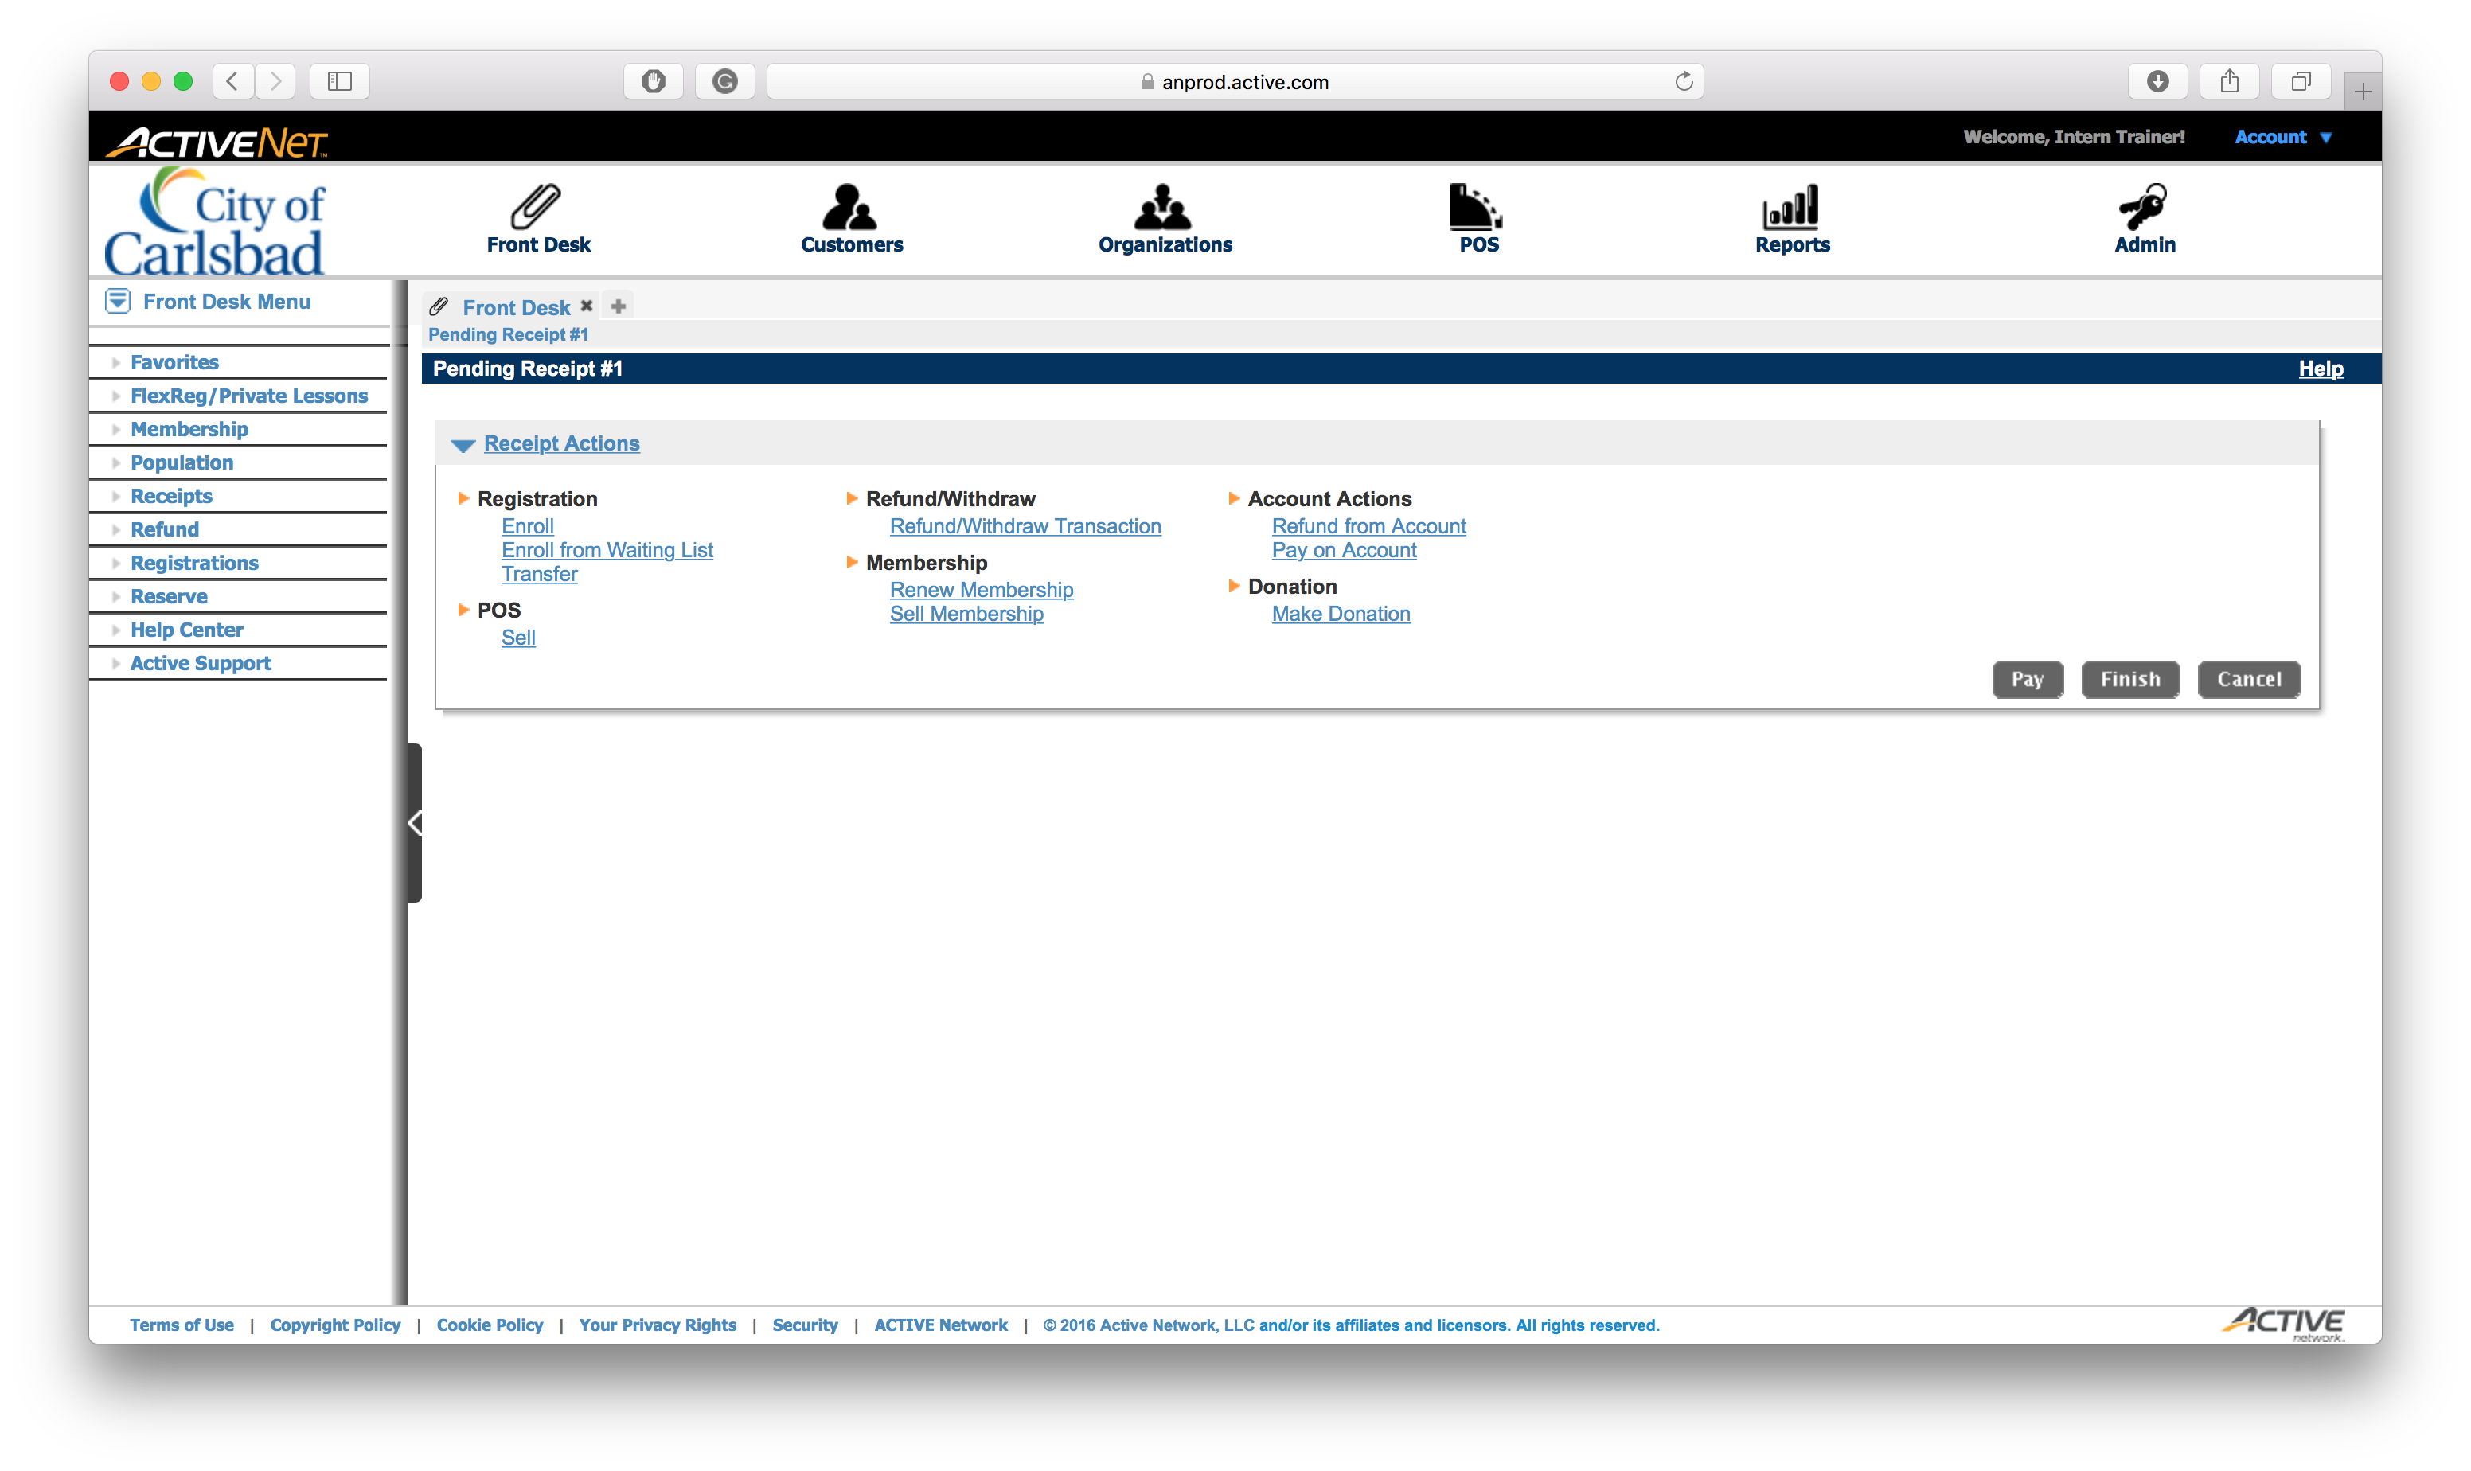
Front Desk
This is the main page. It has several shortcuts already set for you.
Tap Another Banner Icon
to Continue
Back
Finish
Next

Slide 11
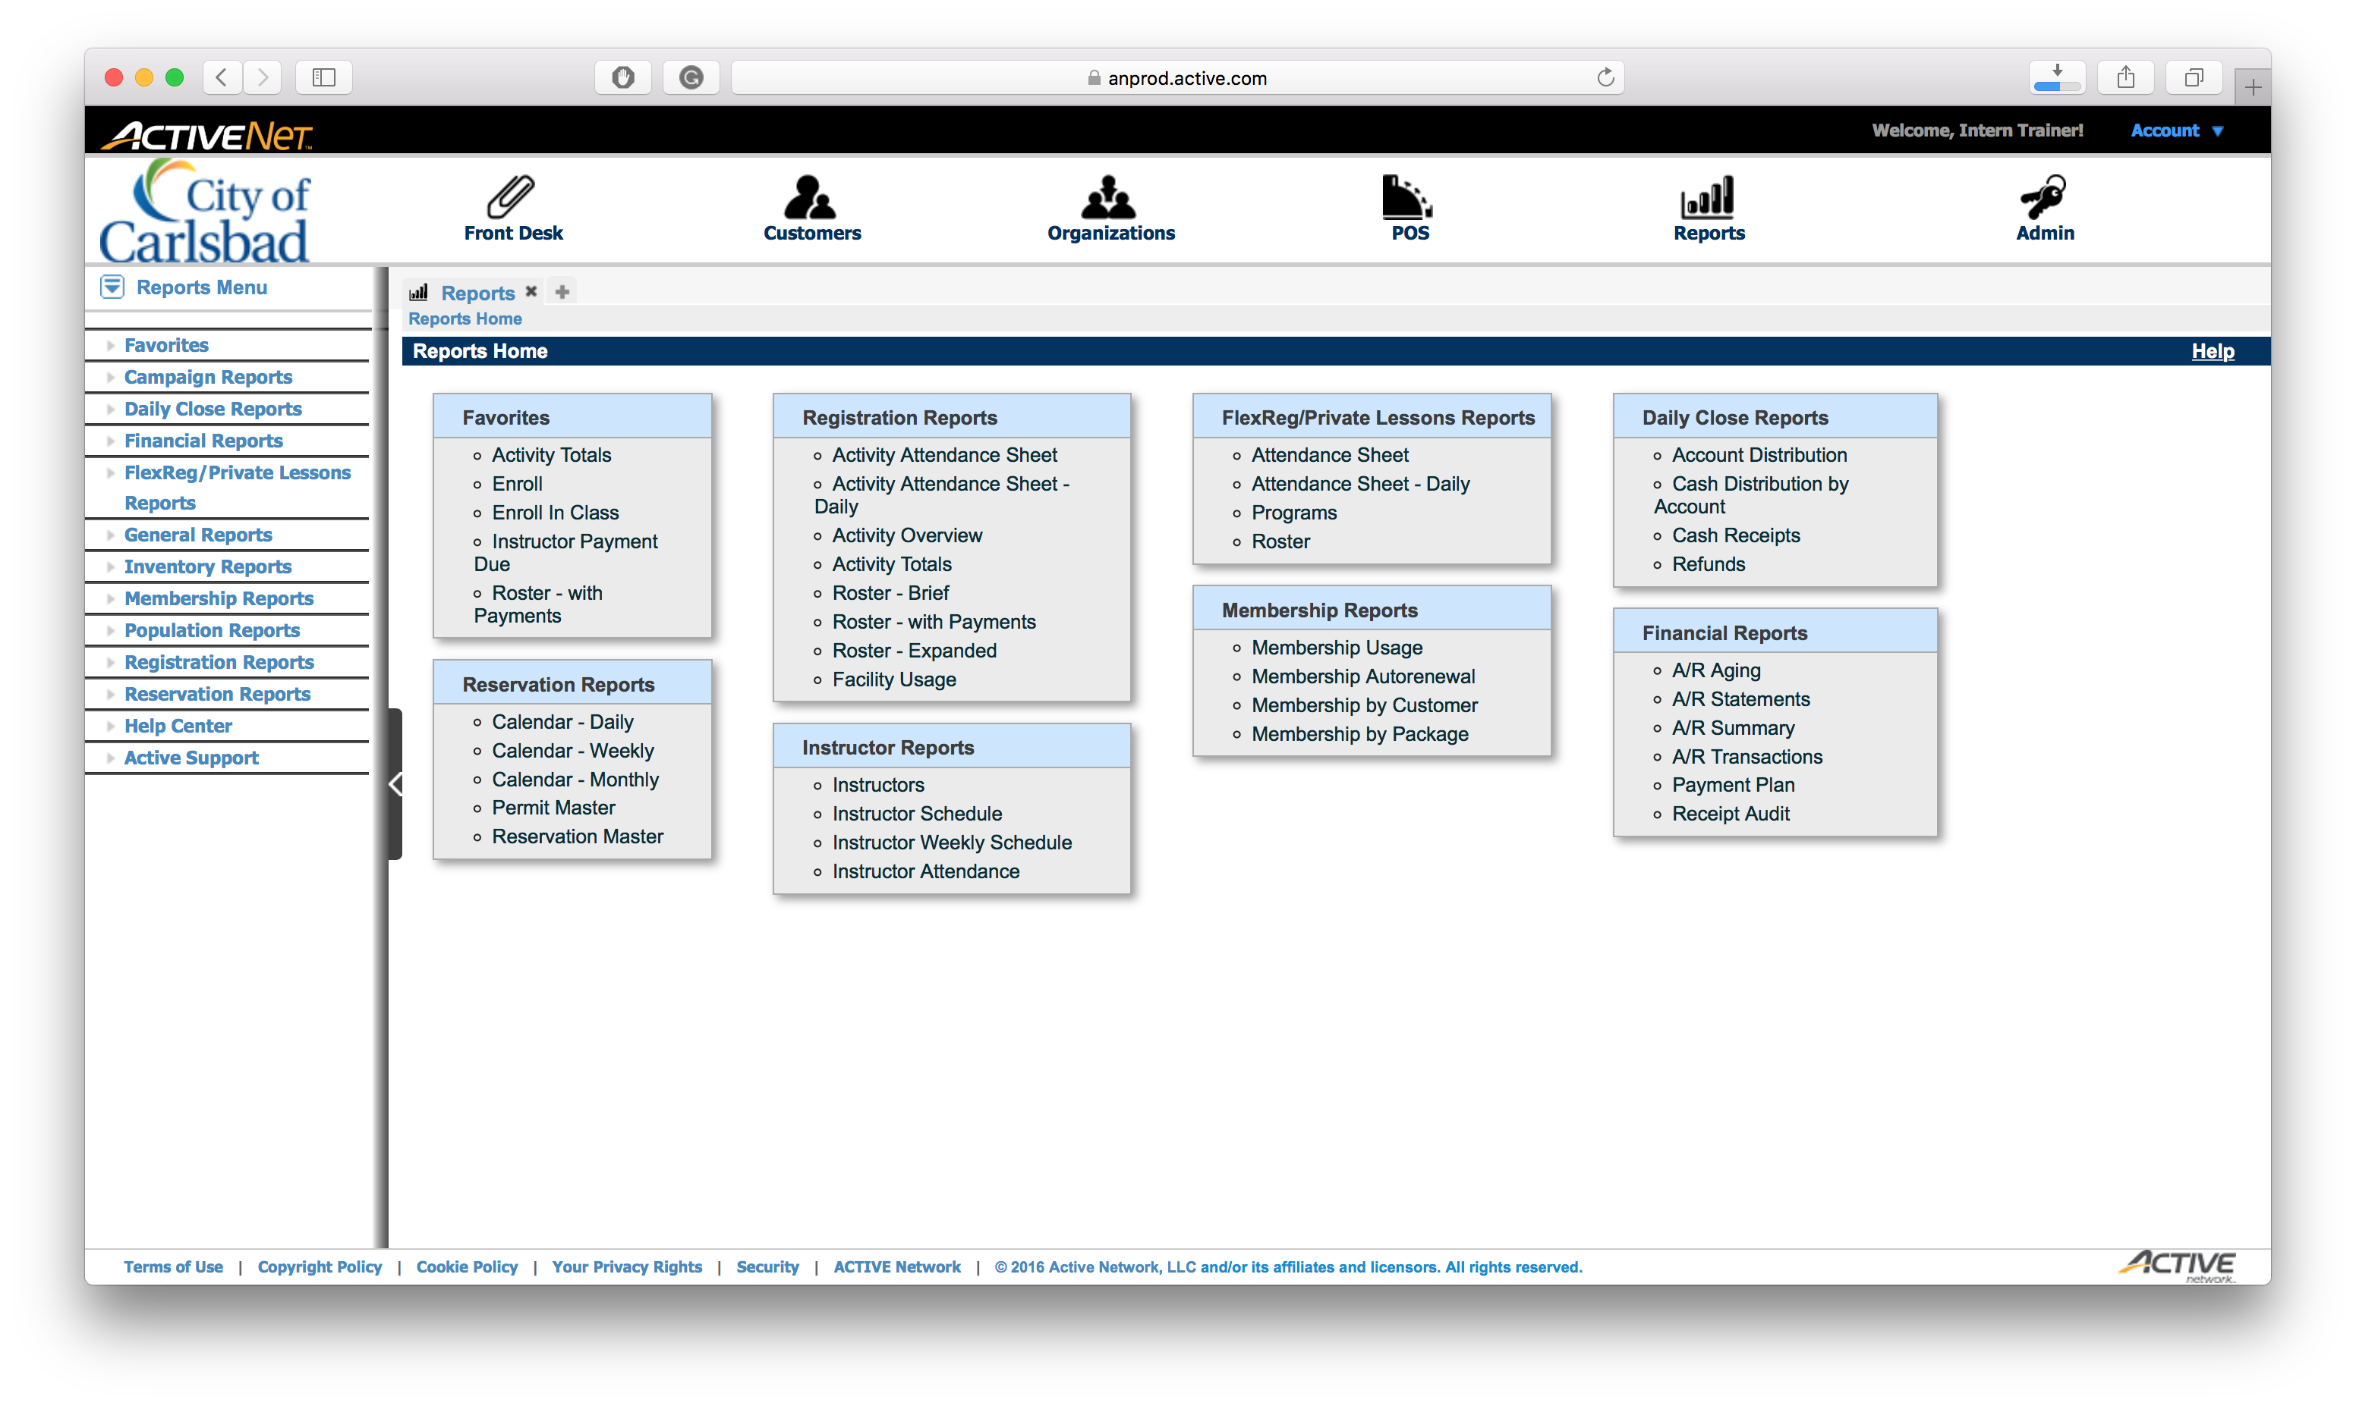
Customers
You can search for customers based on several criterion.
To broaden the results,
NOTE: less is more.
Tap Another Banner Icon
to Continue
Back
Finish
Next

Slide 12
Reports
You have access to many reports. Common ones you may encounter include:
A/R Aging &
Cash Receipts
Tap Another Banner Icon
to Continue
Back
Finish
Next

Slide 13
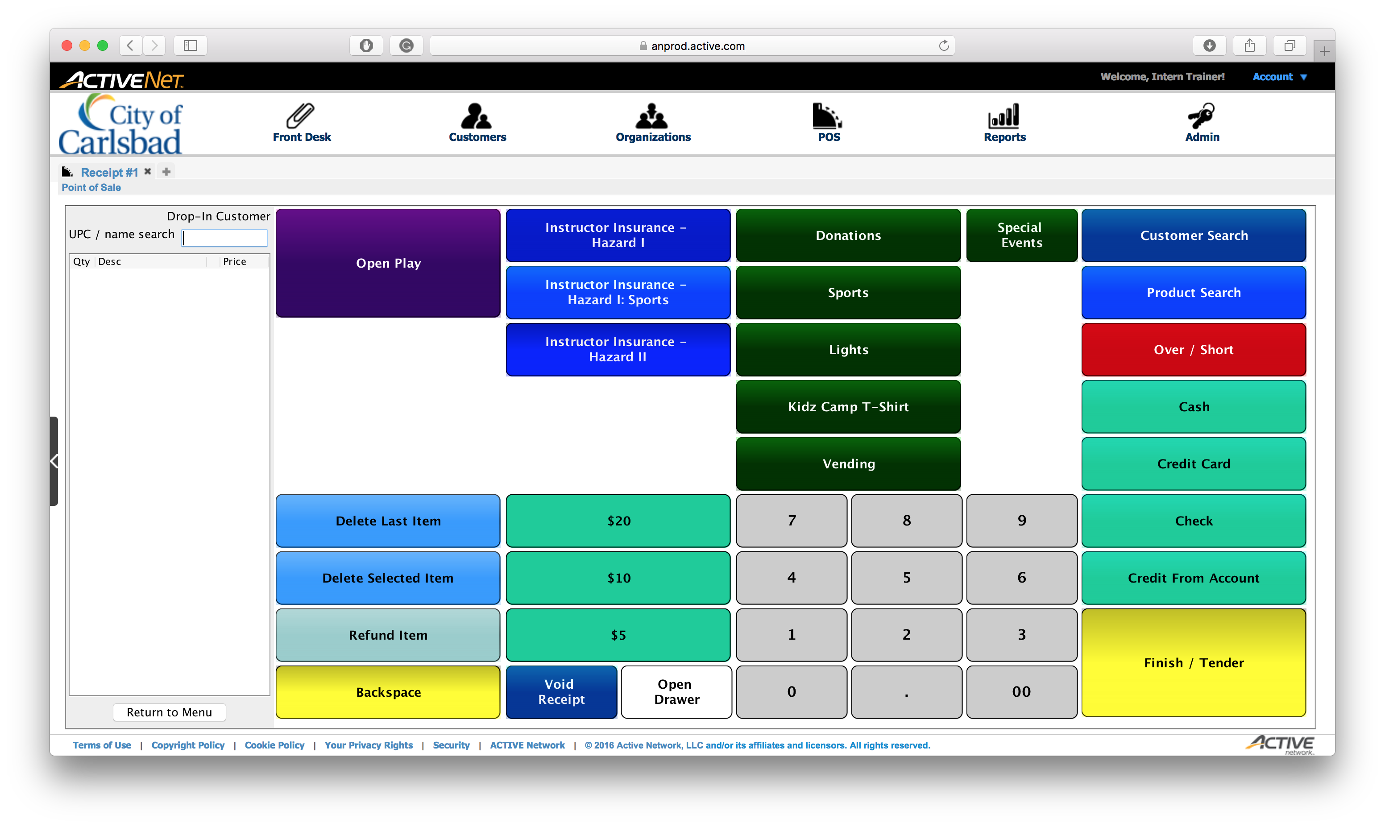
POS
Your screen may appear differently as each location has different products.
Ensure your workstation is correct at each login!
Tap Another Banner Icon
to Continue
Back
Finish

